Slide 1
Hadoop Fundamentals

Slide 2
Pre - requisites
Java Essentials (Optional for Java Experienced / Background Students)
Complete Unit 1.0
Faculty Video Lecture
Reading Material
Self Assessment Quiz Complete
Problem Solving Complete

Slide 3
Session Content (Some Essential Concepts)
Queries on Unit 1
Hadoop Definition
Hadoop Components – Hadoop Daemons
Computer Racks and Rack Awareness
Anatomy of File Read
Anatomy of File Write
HDFS Architecture
Data Visualization Techniques
Map Reduce Process Flow (WIP – Next Session)

Slide 4

Queries on Unit 1

Slide 5

Hadoop Definition
Apache Hadoop is a framework that allows for the distributed processing of large data sets across clusters of commodity computers using a simple programming model.
It is an Open-source Data Management framework with scale-out storage & distributed processing capabilities.

Slide 6
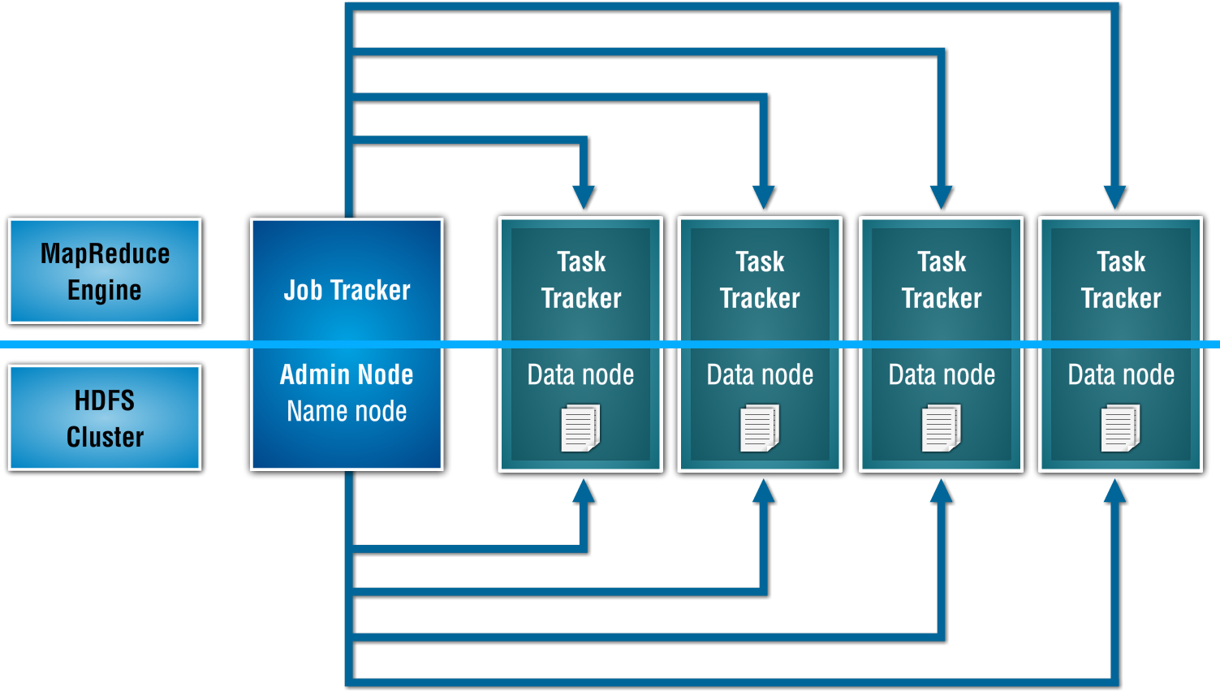
Hadoop Components (Daemons)

Slide 7
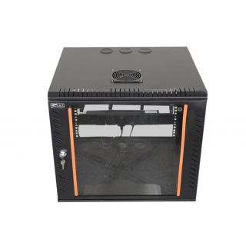

Computer Racks
A computer rack is a physical chassis that can house multiple computers or servers simultaneously. It is a mounting rack that has the ability to install more than one computer
Horizontal Rack
Vertical Rack

Slide 8
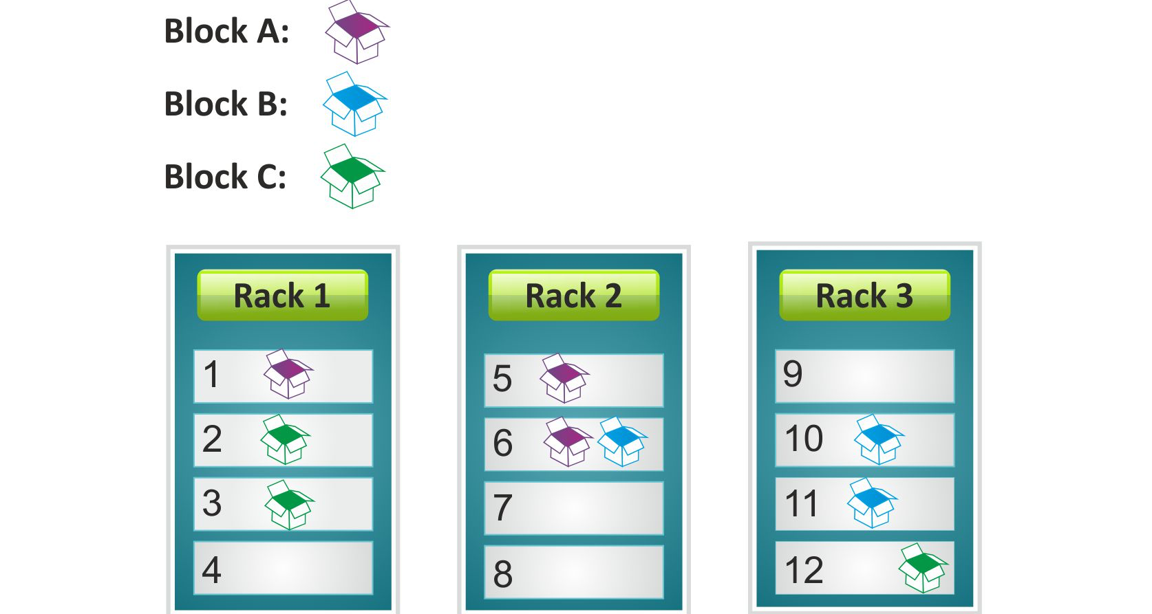
Rack Awareness
In Hadoop, blocks are saved in rack aware fashion

Slide 9
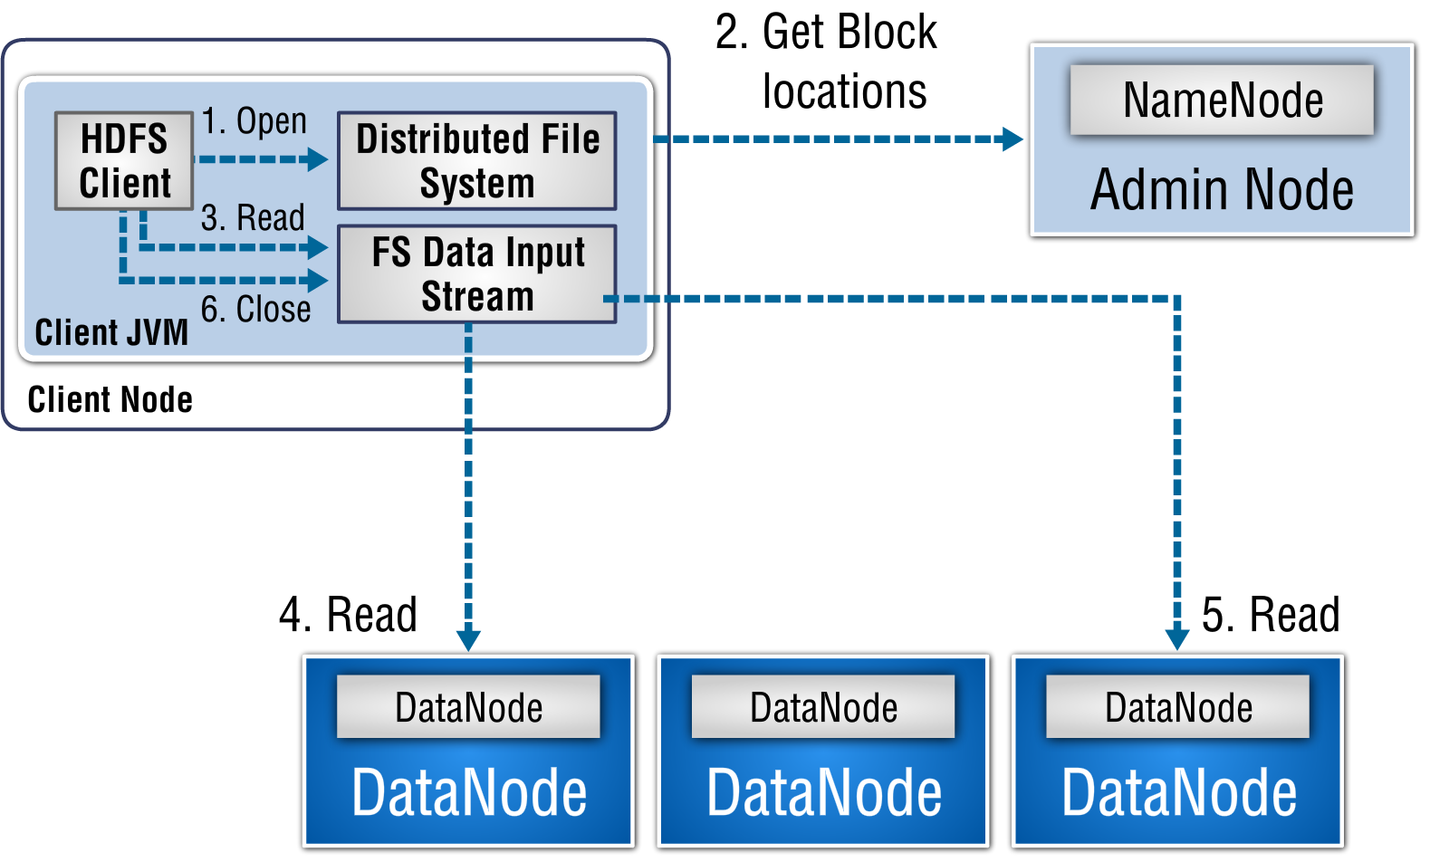
Anatomy of File Read

Slide 10
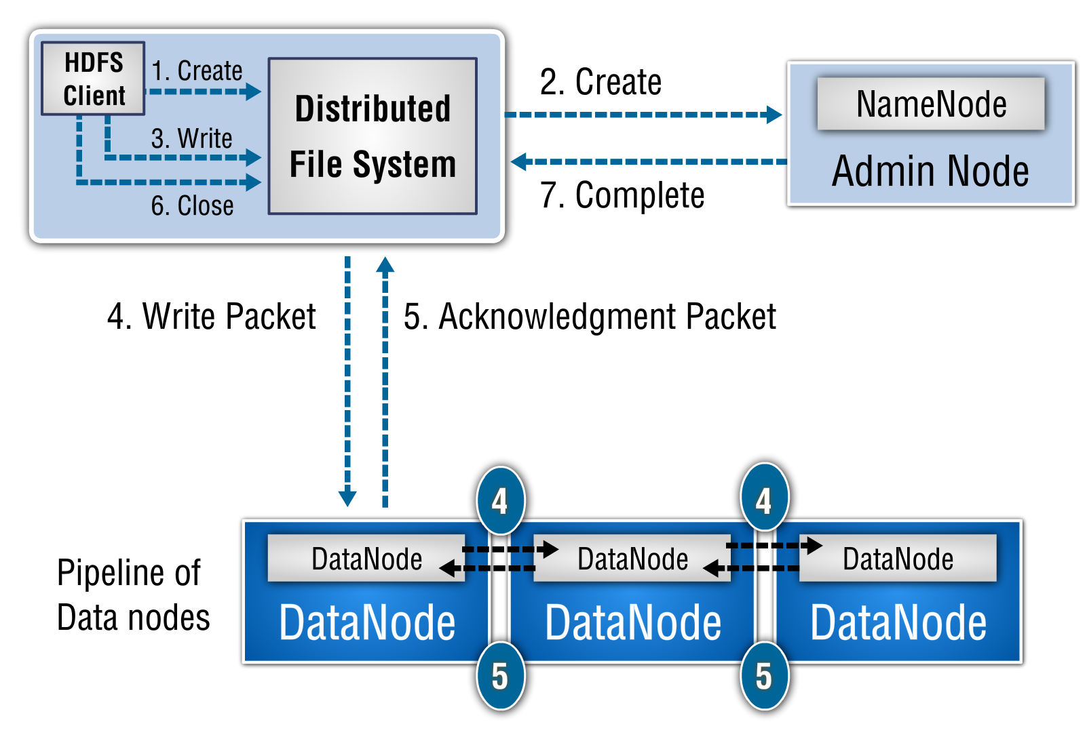
Anatomy of File Write

Slide 11
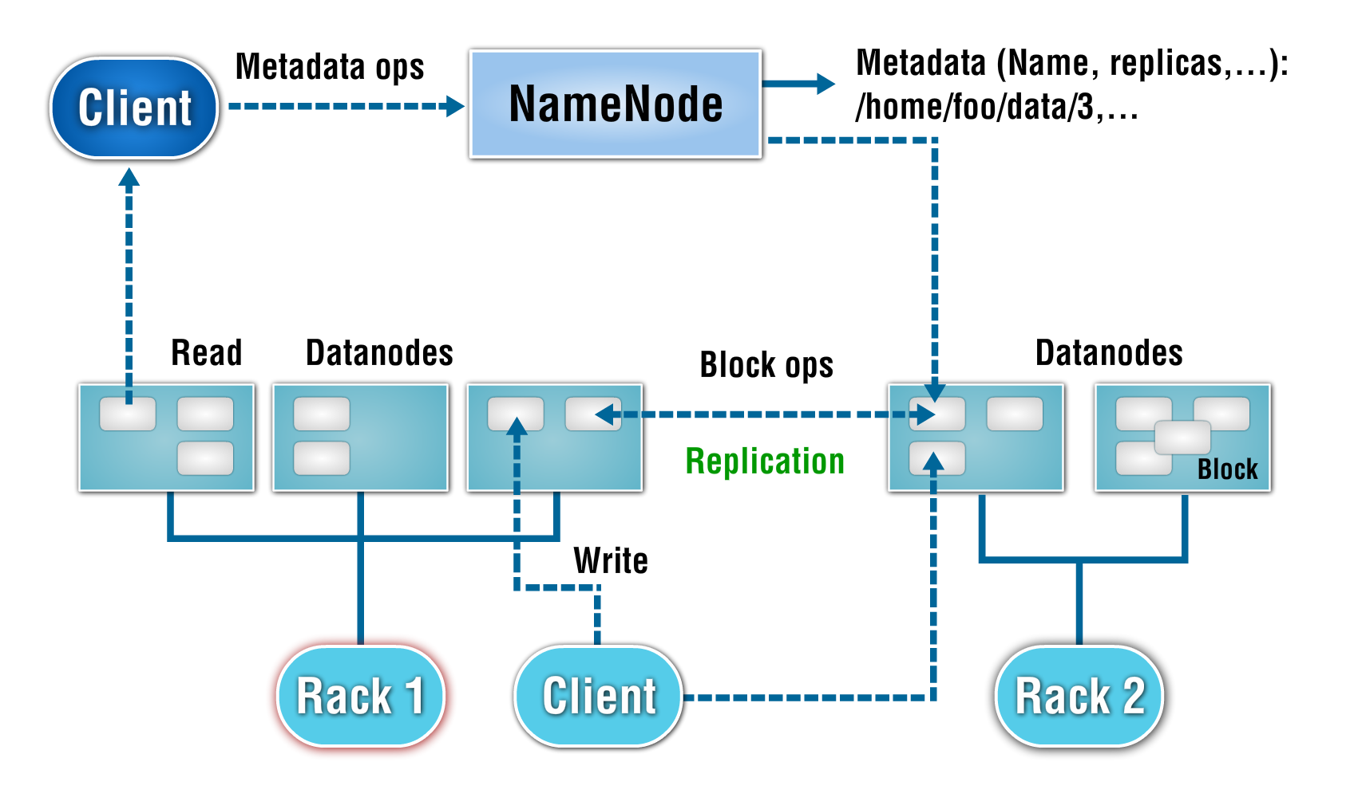
HDFS Architecture

Slide 12
HDFS Architecture

Slide 13
Data Visualization Techniques
One of the very popular data visualization language is R
R is an open source programming language
It was created in New Zealand by Ross Ihaka and Robert Gentleman in 1991
It is based on another language called S
It comprises of base packages and lots and lots of addition utility modular packages (We’ll see one such package today)
Amazing graphical capabilities (We’ll see some in our sessions)

Slide 14
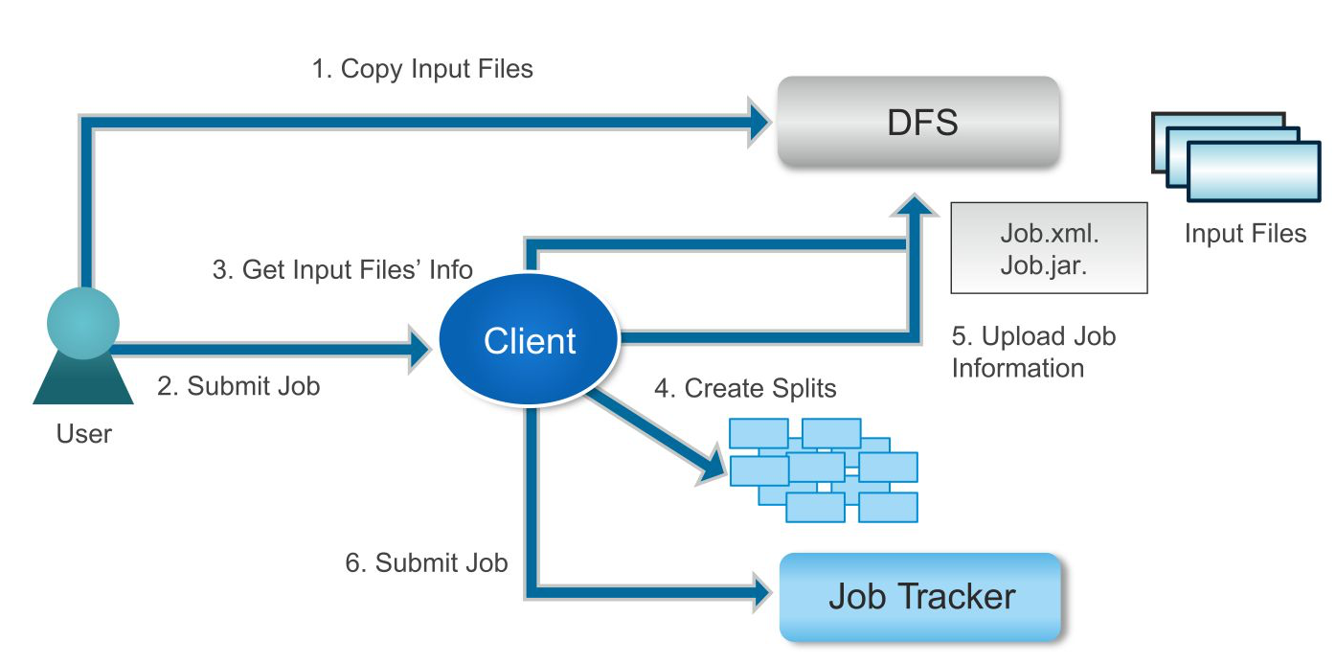
Map Reduce Process Flow

Slide 15
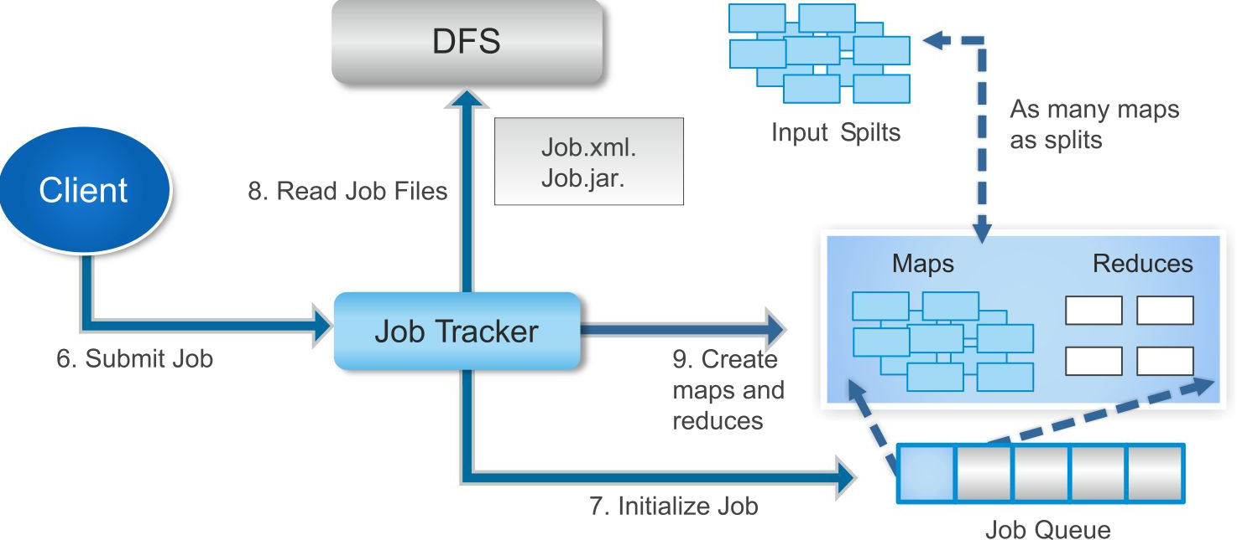
Map Reduce Process Flow (cont.)

Slide 16
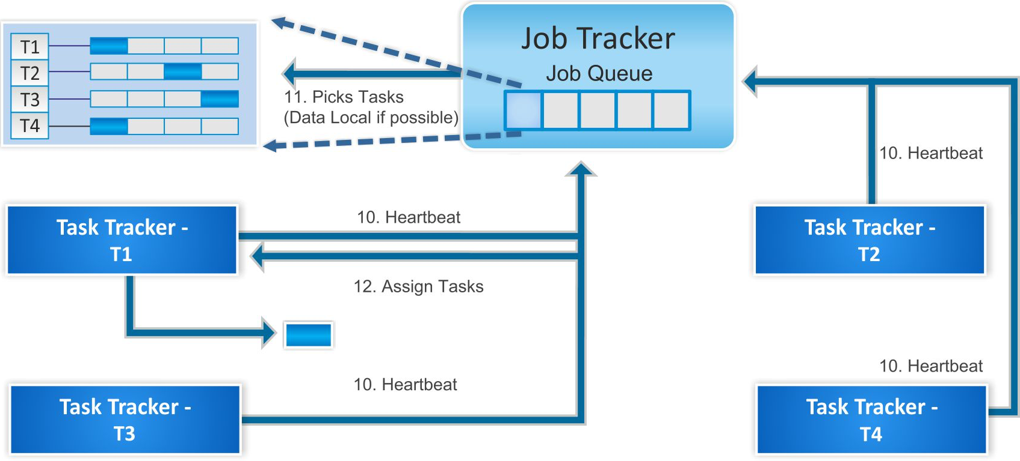
Map Reduce Process Flow (cont.)

Slide 17
Queries

